Slide 1
Explainable Machine Learning for Cardiovascular Risk Prediction Using Random Forest
by Ayusha Das (2520039624)

Slide 2
Abstract
1
Heart disease is a major health concern, and spotting at-risk patients early gives doctors a chance to step in on time.
2
In this project, we use structured patient health data to predict cardiovascular risk.
3
We start with Exploratory Data Analysis (EDA) to check the quality of the data and see how the patient attributes relate to each other.
4
Four classification models are then compared: Logistic Regression, Decision Tree, Random Forest and XGBoost.
5
Random Forest is used to find the most important features, and SHAP explains the predictions both across the whole dataset and for individual patients.

Slide 3
Problem Statement & Case-Based Scenario
Machine learning can predict cardiovascular disease from patient health data, but a prediction alone doesn't tell us why a patient was flagged as at risk.
Imagine a healthcare organization that wants to study its past patient records and identify who is at risk of cardiovascular disease.
The doctors and staff using the system also need clear reasons behind each individual prediction.
INPUTS
Age, gender, height, weight, blood pressure, cholesterol, glucose, smoking, alcohol use and physical activity.
OUTPUT
A cardiovascular disease prediction, along with the key factors that led to it.

Slide 4
Existing System – Research Paper
01
02
03
04
Existing research on explainable ML already pairs cardiovascular risk prediction with ways of interpreting the model.
The paper we referred to compares several machine learning models and uses SHAP to explain what drives each prediction.
A common problem with many ML models is that it's hard for users to understand how they reach their decisions.
Our project modifies this approach by using the Kaggle cardiovascular dataset directly, comparing Logistic Regression, Decision Tree, Random Forest and XGBoost, and focusing on Random Forest feature importance and SHAP-based patient-level explanations.

Slide 5
Proposed System
01
02
03
We use the Kaggle Cardiovascular Disease Dataset, which has 70,000 patient records.
We carry out hands-on EDA and look for data-quality problems before building any model.
We then compare Logistic Regression, Decision Tree, Random Forest and XGBoost.
04
05
06
Random Forest is used to find which features matter most.
SHAP is used to explain predictions for the whole dataset and for individual patients.
The result is a cardiovascular risk prediction workflow that is easier to understand and trust.

Slide 6
Dataset & Exploratory Data Analysis
70,000
13
0
0
rows
columns
missing values
duplicate rows
DATASET
TARGET VARIABLE
The Cardiovascular Disease Dataset from Kaggle.
cardio (0 = no cardiovascular disease, 1 = cardiovascular disease).
EDA
FINDING
We looked at distributions, categorical features and correlations, calculated BMI, and checked for outliers.
EDA also flagged some suspicious blood-pressure values that had to be cleaned up during preprocessing.

Slide 7
Preprocessing & Algorithms
01
We removed 29 records that had invalid blood-pressure values (zero or negative).
04
The data was split into 80% for training and 20% for testing.
02
Age was converted from days into years, and BMI was calculated from height and weight.
05
Algorithms used: Logistic Regression, Decision Tree, Random Forest and XGBoost.
03
The ID column was dropped, since it only identifies a record and doesn't help in prediction.
06
Random Forest is our main model for feature importance and SHAP-based explanations.

Slide 8
Model Comparison – Test Accuracy
72.58%
XGBoost: the highest of all four models
XGBoost scored highest, but Random Forest still matters here because it gives us feature importance and is the model we use for SHAP explanations.

Slide 9
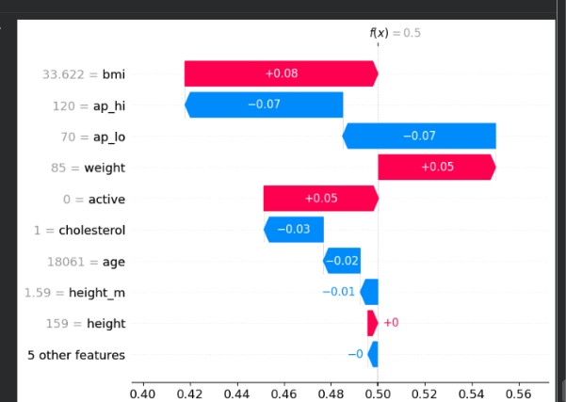
Random Forest Feature Importance & SHAP
MOST IMPORTANT VARIABLES
Patient-Level SHAP Explanation
age
ap_hi (systolic BP)
age_years
BMI
weight
ap_lo (diastolic BP)
Keep in mind that feature importance only shows what the model uses, not what actually causes the disease.

Slide 10
Conclusion
01
This project covers the full workflow, from analysing a cardiovascular dataset to building ML models and explaining their predictions.
04
XGBoost gave the best test accuracy of the four, at 72.58%.
02
EDA helped us spot data-quality issues and guided how we preprocessed the data.
05
Random Forest was used to study feature importance and, together with SHAP, to explain the predictions.
03
We implemented and compared four classification algorithms.
06
Overall, our approach aims to make cardiovascular risk predictions easier for users to understand.

